Slide 1









Predictive health: Forecasting Diseases from Patient Vitals

Slide 2











The Analytics team

Slide 3





Today's agenda
Introduction
Project Summary
Purpose of the Project
Sources of Data Used
Website Preview
Data Visualization Charts and graphs
Conclusions

Slide 4
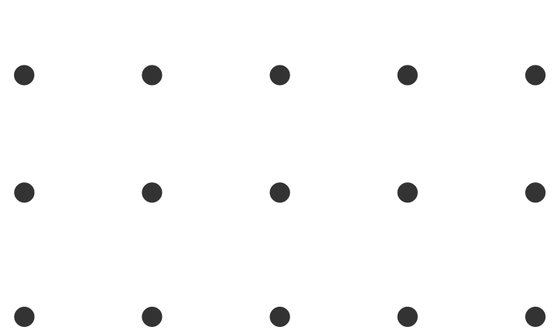
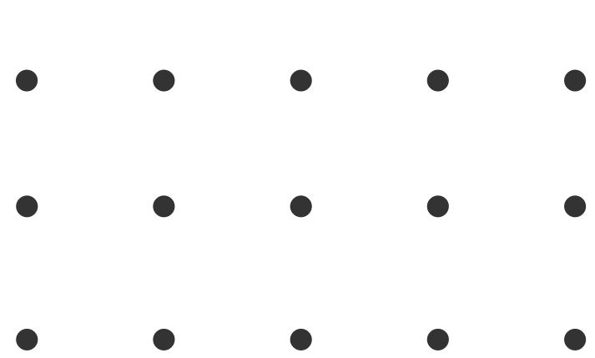
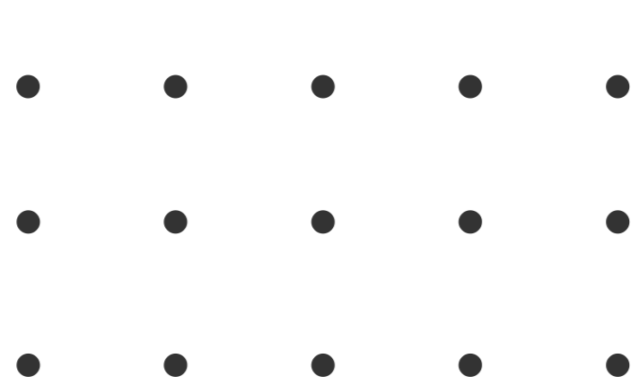
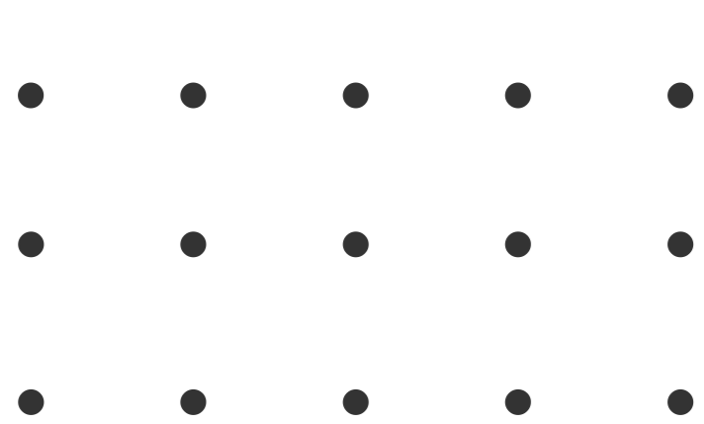

INTRODUCTION
Introducing our cutting-edge project: "Disease Prediction System using Vital Data and World Map Visualizations." This innovative project aims to accurately predict diabetes, liver disease, and breast cancer by leveraging advanced algorithms such as decision tree classifier, k-neighbors classifier, and random forest classifier. With a five-step methodology encompassing data preprocessing, exploratory data analysis, model training, serialization, and web application development, we offer a comprehensive solution for disease prediction and insightful world map visualizations of cases and deaths across various countries. Join us on this journey to revolutionize disease diagnosis and mapping for a healthier future.

Slide 5
PROJECT SUMMARY
The Disease Prediction System utilizes vital data and advanced algorithms to predict diabetes, liver disease, and breast cancer accurately. It follows a five-step methodology: data preprocessing, exploratory data analysis, model training, serialization, and web application development using Flask. The project includes decision tree, k-neighbors, and random forest classifiers for precise predictions. World map visualizations showcase disease distribution and deaths in different countries. The system aims to revolutionize disease diagnosis, empowering healthcare professionals and individuals with valuable insights for informed decision-making on a global scale.

Slide 6
PURPOSE OF THE PROJECT
1. Provide accurate disease predictions through vital data for diabetes, liver disease, and breast cancer.
2. Utilize advanced algorithms (decision tree, k-neighbors, random forest) for reliable predictions.
3. Display disease distribution and deaths on world maps to identify high-risk regions.
4. Create a user-friendly web app for informed decisions and improved global health.
THE

Slide 7
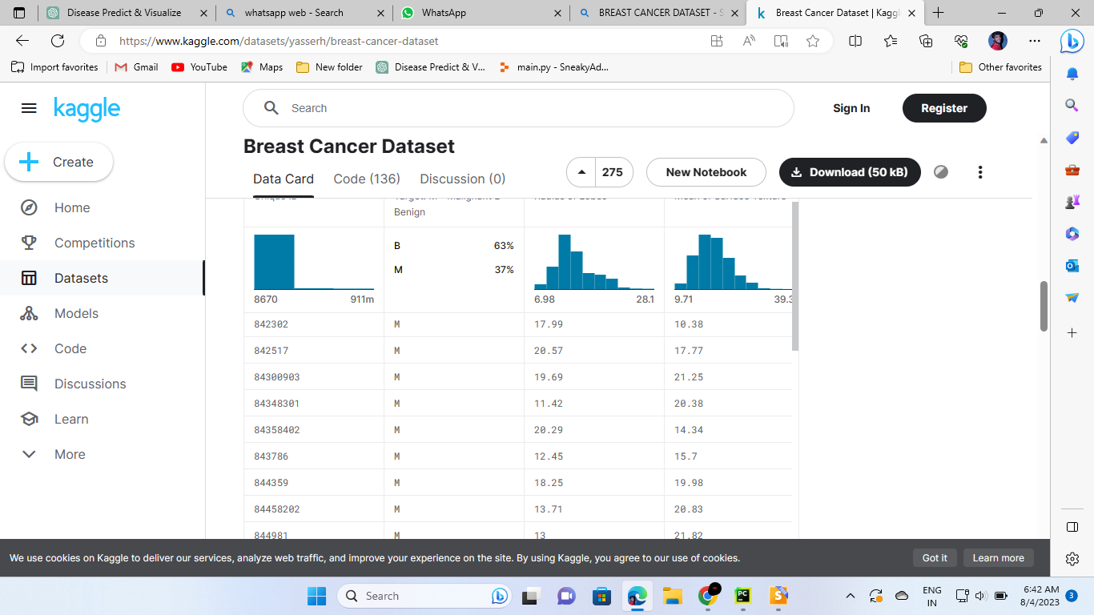
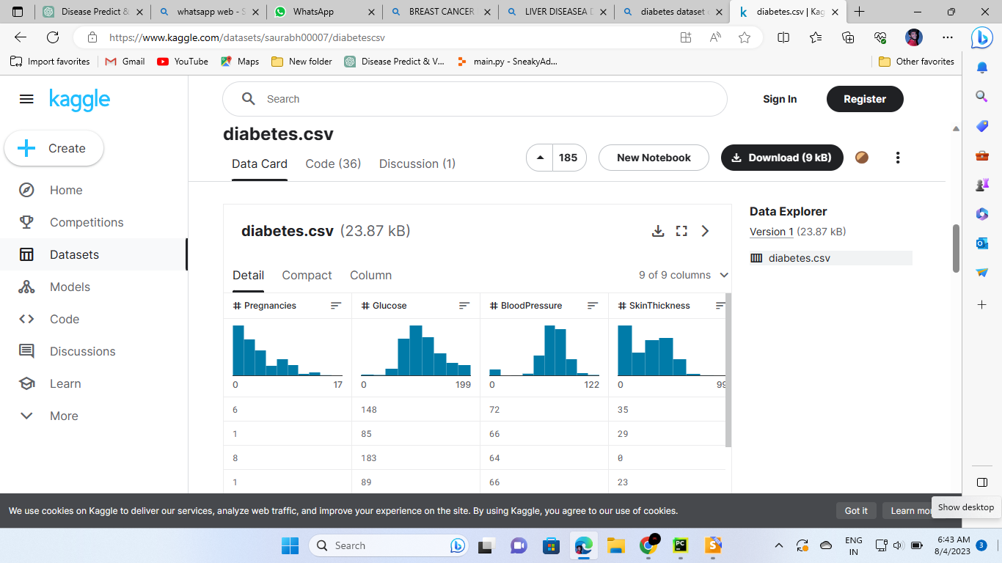
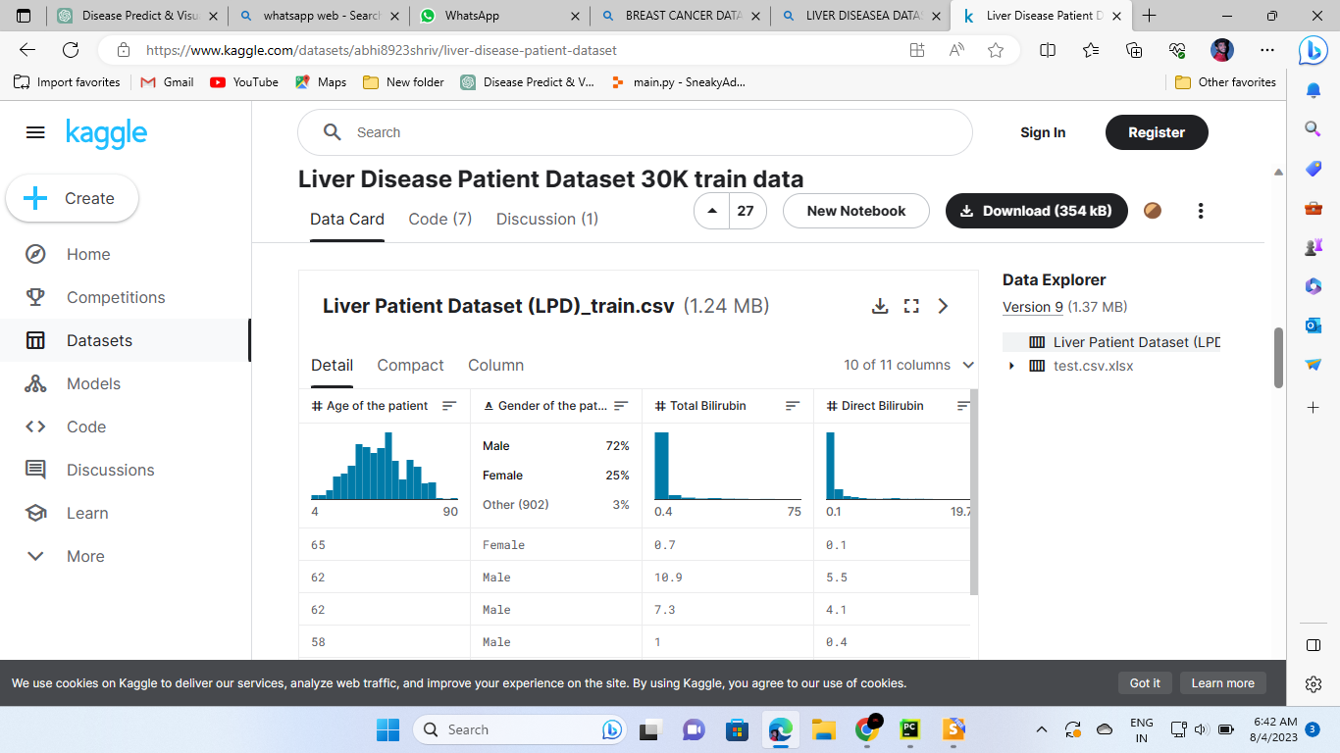
SOURCES OF DATA USED

Slide 8


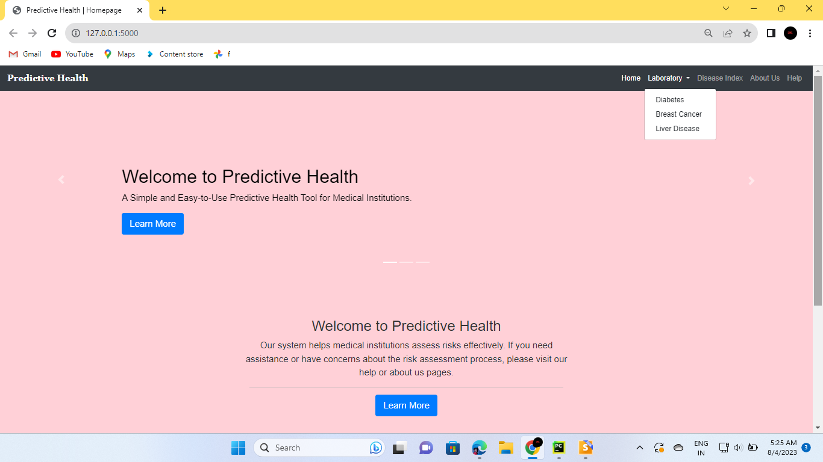
WEBSITE PREVIEW

Slide 9




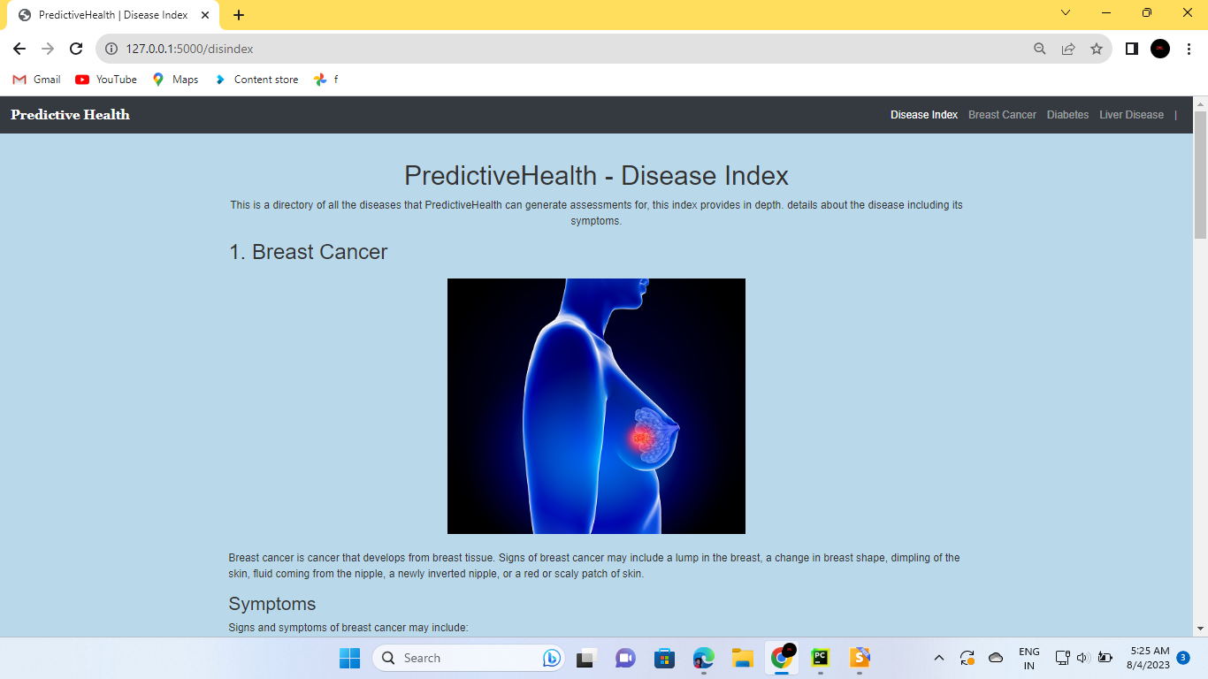
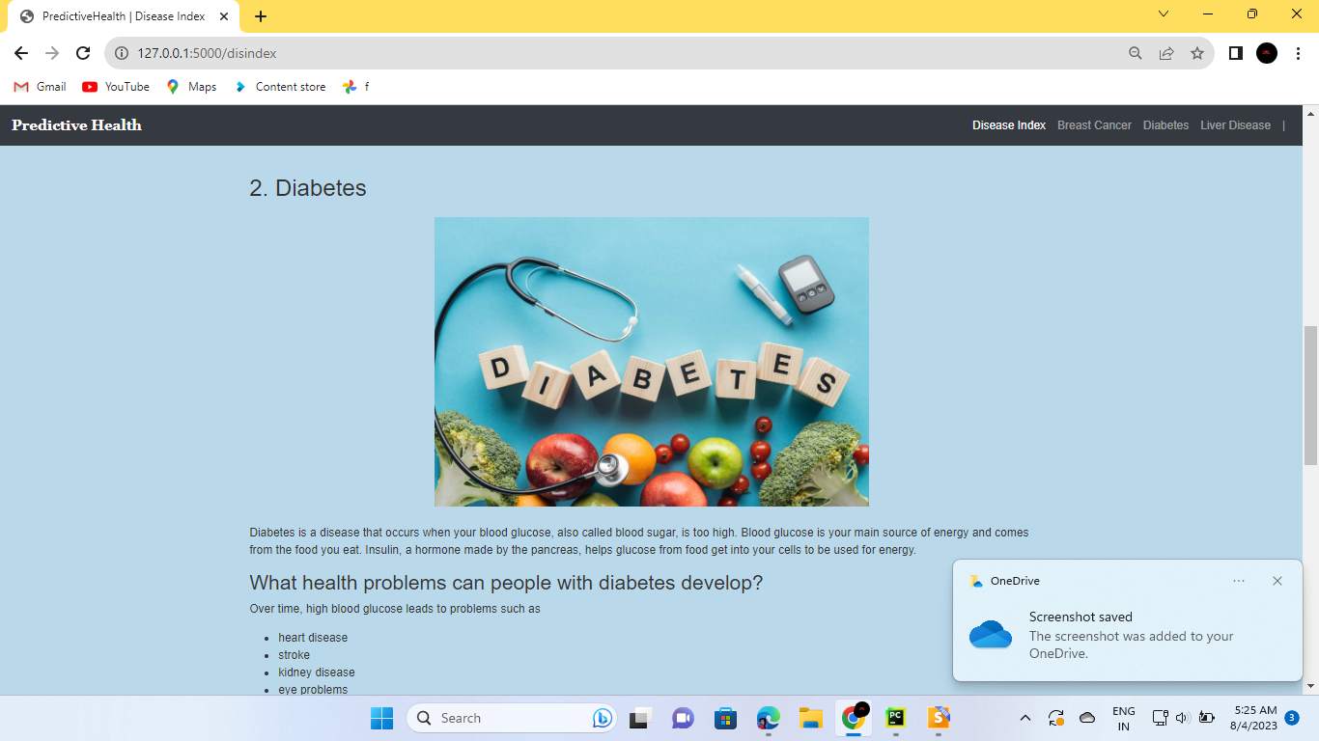
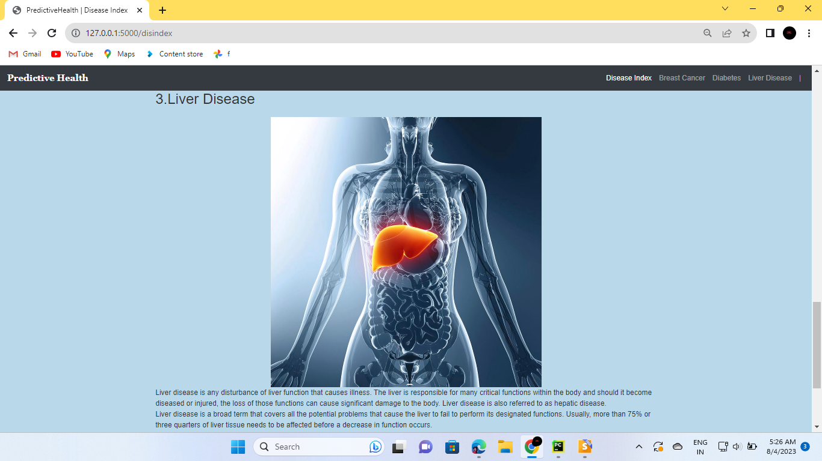
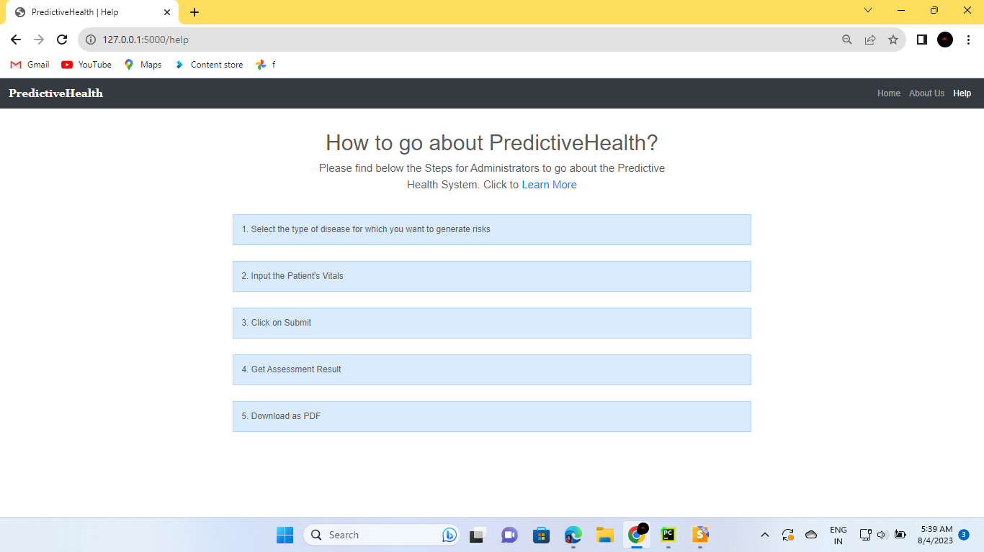

Slide 10
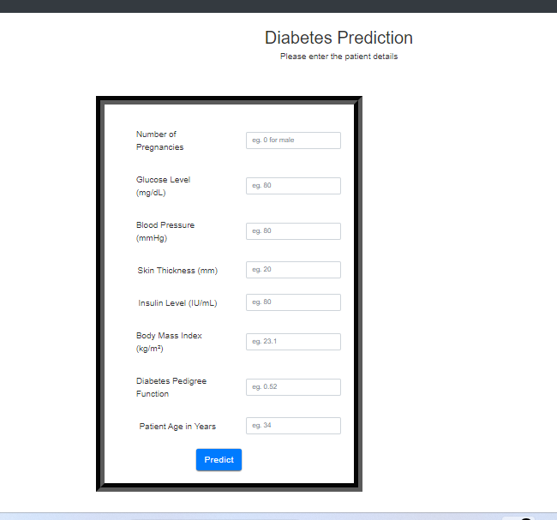
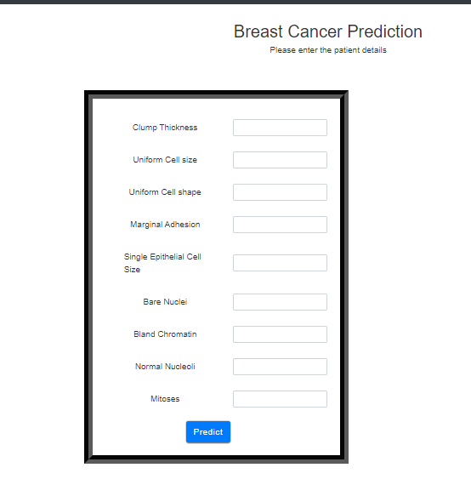
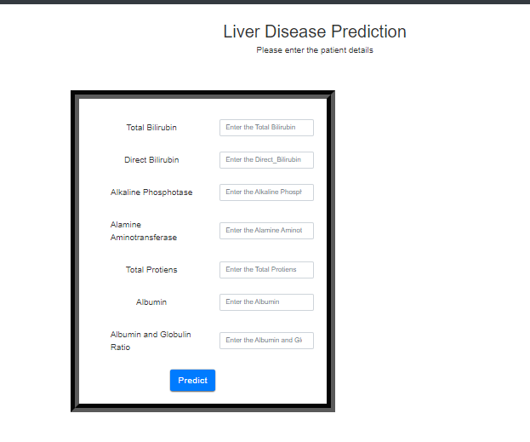
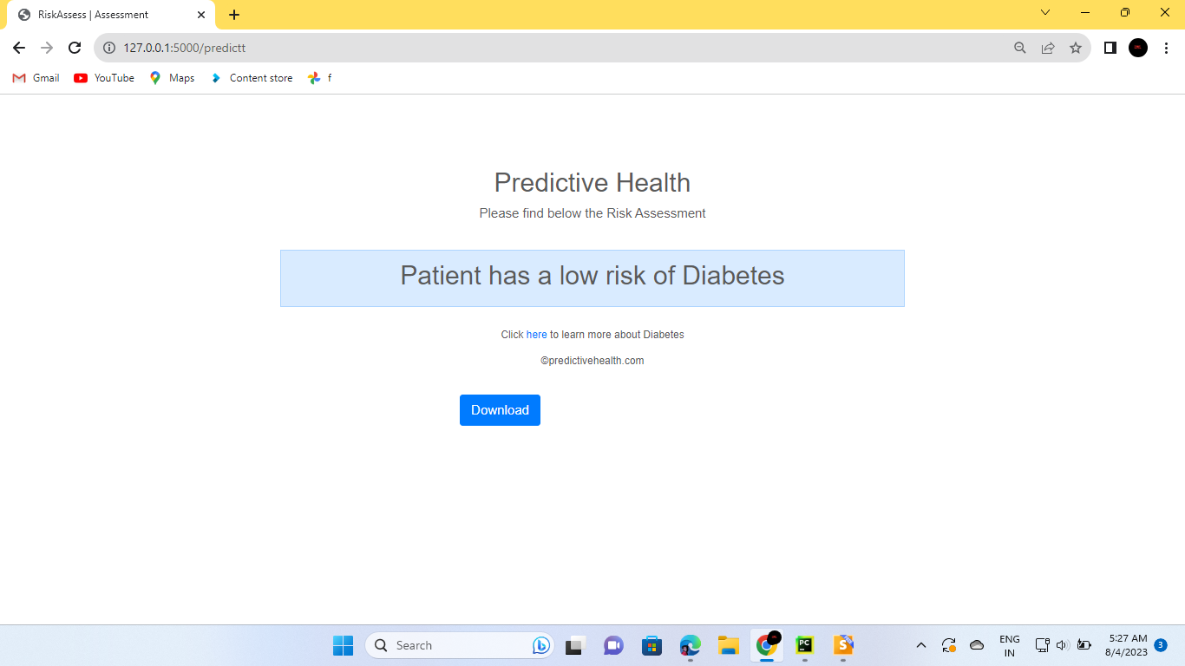
INPUT
OUTPUT

Slide 11
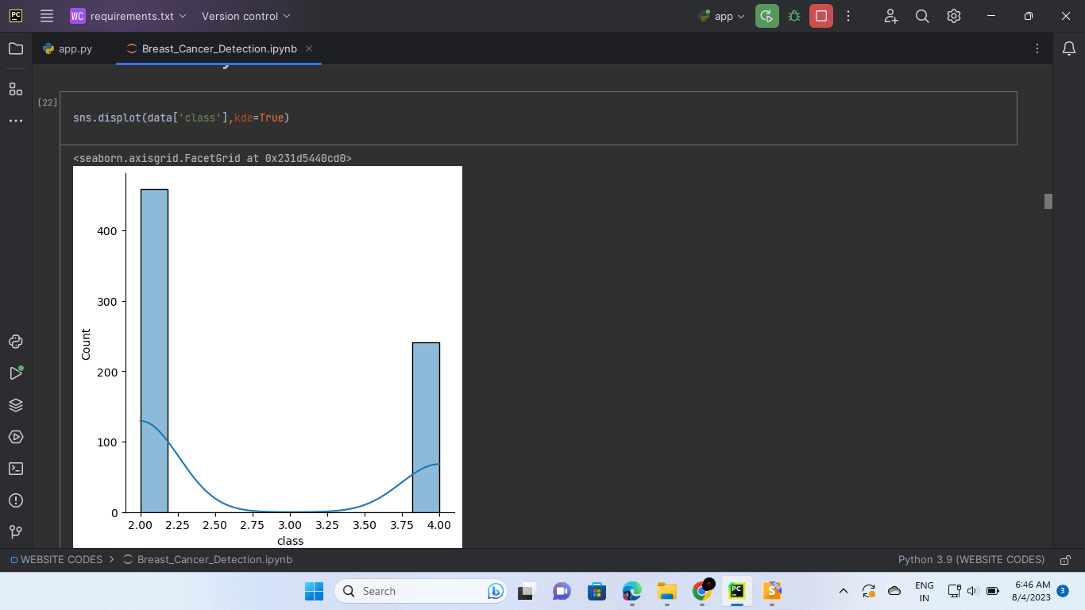
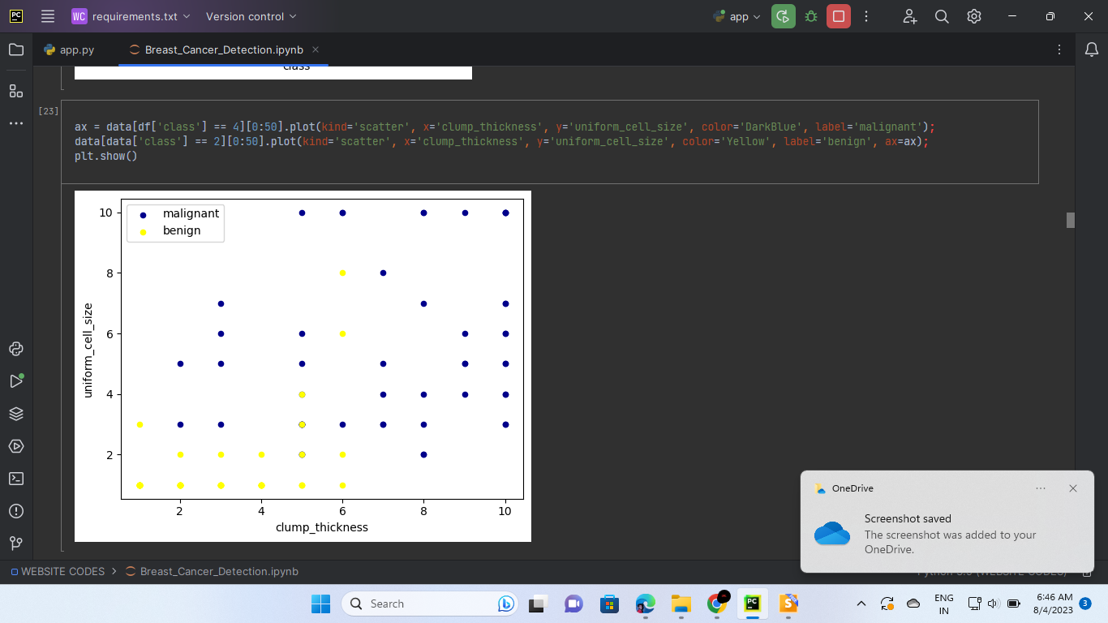
DATA VISUALIZATION CHARTS AND GRAPHS

Slide 12
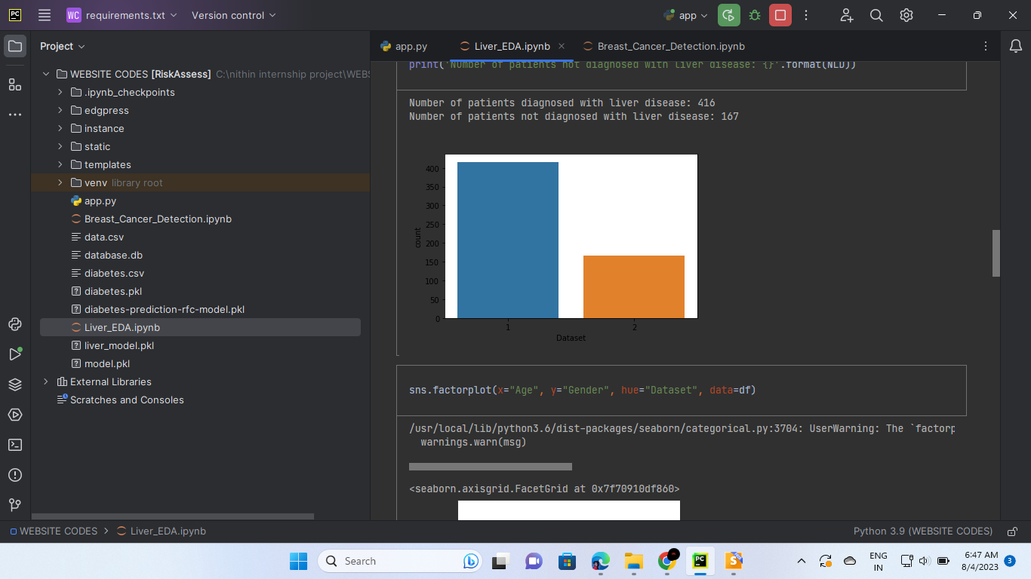
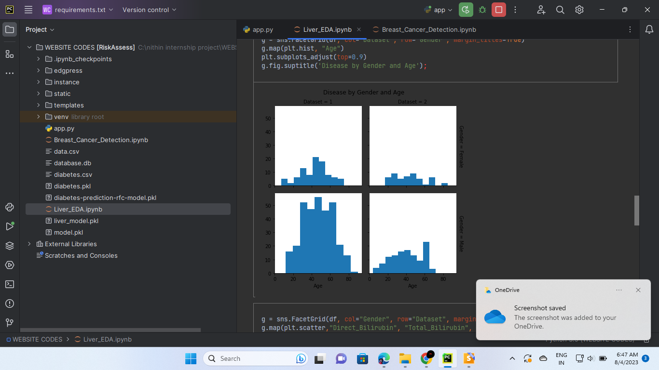

Slide 13
CONCLUSION
1. Disease prediction system uses vital data and advanced algorithms (decision tree, k-neighbors, random forest) to accurately predict diabetes, liver disease, and breast cancer.
2. Five-step methodology - data preprocessing, exploratory analysis, model training, serialization, and Flask web app development - ensures a comprehensive and efficient solution.
3. Flask web app empowers healthcare professionals and individuals with user-friendly disease prediction and visualization tools, promoting informed decision-making for improved global health outcomes.

Slide 14







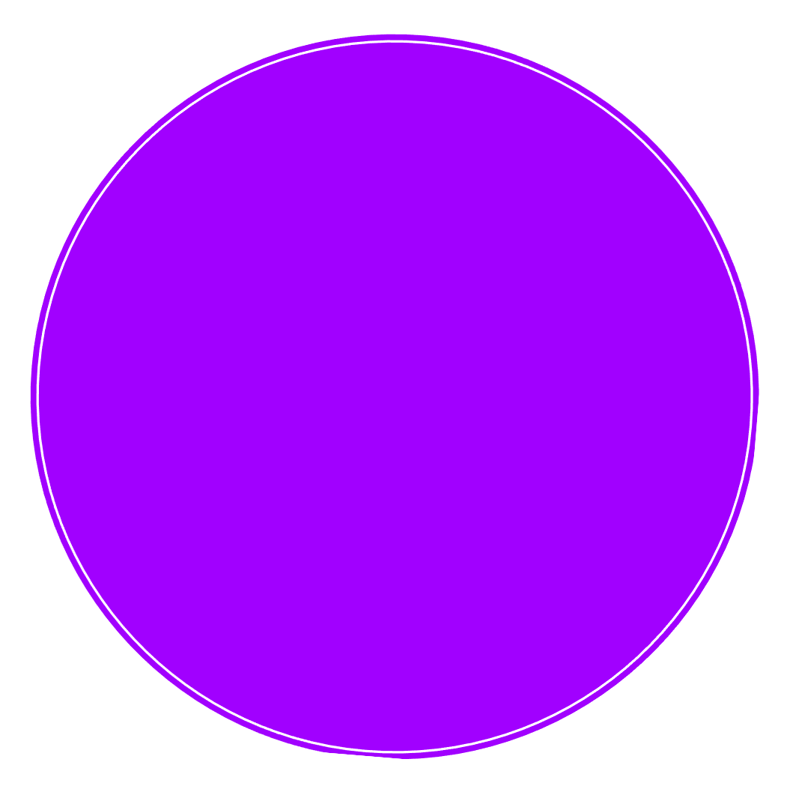







Thank you!

